Slide 1

Bytes Brigade
TITLE PAGE
Problem Statement ID –1637
Problem Statement Title-Mobile App for Direct Market
Access for Farmers
Theme-Agriculture , Food Tech & Rural Development
PS Category- Software
Team ID-
Team Name (Bytes Brigade)

Slide 2



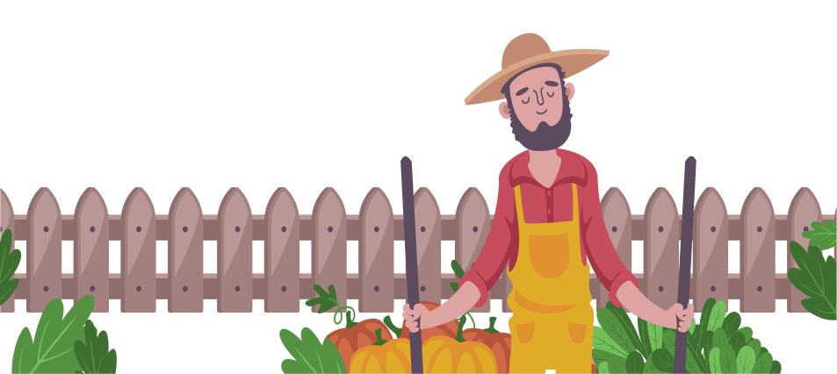


IDEA-FARMBRIDGE
Bytes Brigade
Direct Market Access
The app enables farmers to connect directly with consumers and retailers, bypassing intermediaries for increased profitability.
01
User-Friendly Interface
Designed with simplicity in mind, the app ensures that farmers can easily navigate and manage their listings with minimal technical skills.
02
Wastage of food is reduced:
By facilitating local transactions and showing the expiry date only to the farmer and they can sell the product throw online by viewing notification.
03
Self-Determined Pricing
Farmers can set their own prices for their produce, giving them control to maximize their earnings based on market conditions.
04

Slide 3







TECHNICAL APPROACH
Bytes Brigade
FLUTTER
NODE JS
FIGMA
BACKEND
UI/UX DESIGN
FRONTEND
UPI
FIREBASE
MONGODB
DATABASE
PAYMENT GATEWAY
PUSH NOTIFICATION

Slide 4
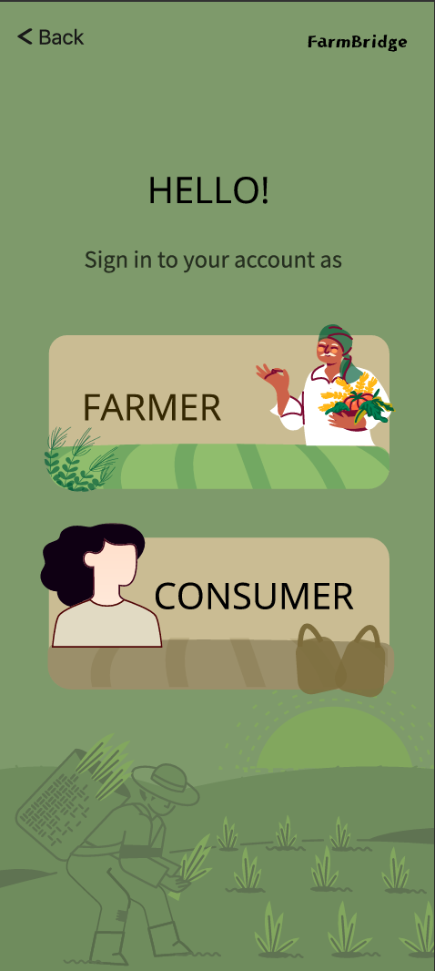
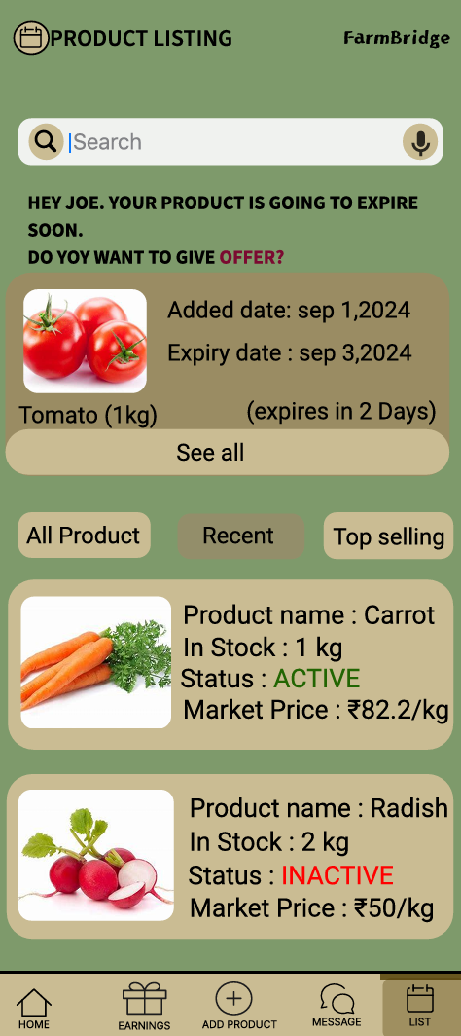
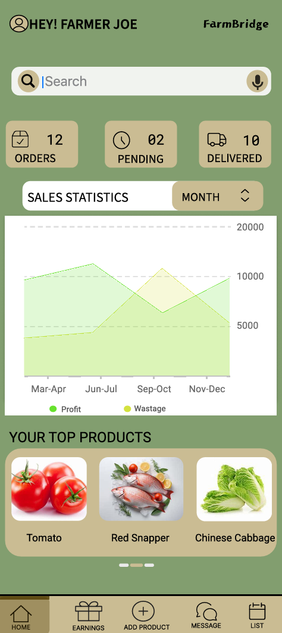
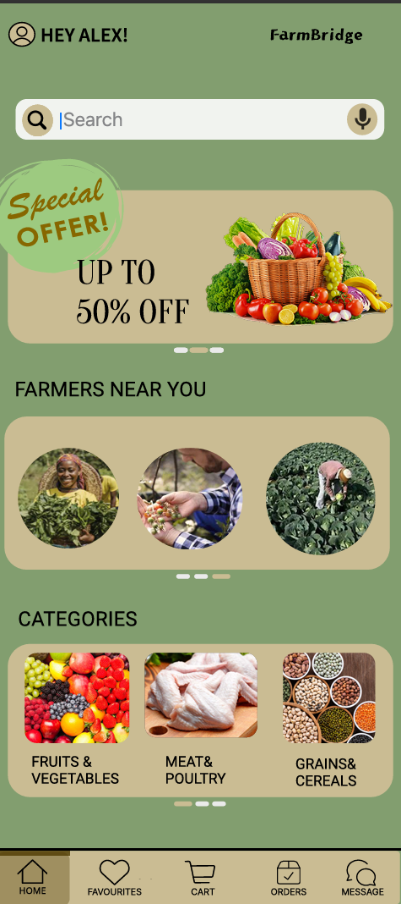

FEASIBILITY AND VIABILITY
Bytes Brigade
User interface

Slide 5







Bytes Brigade
IMPACT AND BENIFITS
Enhanced Consumer Experience
Consumers have the option to visit farms and purchase products directly, fostering a better understanding of where their food comes from and ensuring fresher produce.
Increased Trust and Transparency
The app facilitates transparent interactions between farmers and consumers, building trust and confidence in the quality and authenticity of the products.
Economic Growth
Farm Bridge
This app stimulates local economies by supporting small-scale farmers, enhancing rural livelihoods, and contributing to the nation’s economic growth.
An mobile app that connects farmer and consumer without intermediate.
Strengthened Agricultural Sector
This app fosters innovation in the agriculture sector, integrating technology to modernize farming practices and market strategies.
Health Benefits
Direct interactions with farmers allow consumers to make informed choices, leading to a greater emphasis on quality and safety of the produce.

Slide 6
RESEARCH AND REFERENCES
Bytes Brigade
Research on existing app(50+)
Eg :Big Hatt ,Farmers fresh zone ,Farmigo etc…,
Farmer need to pay for Intermediate
Only user or farmer can access
Farmer should pay for delivery man
UI/UX Interface is hard
Language issues
Data Analyzing is missing
Offering system is not good
Influencing the Farmers
Some apps are slow
Let’s break all these struggles with
Farm Bridge
Reference link:
Research work on other apps

